Slide 1
DATA 1205 – Visualizations, Leadership
Assignment No. 6
Submitted by,
Nishanth Maria Arul
100813350

Slide 2
Introduction
Three documents were provided as datasets.
The ‘indexprocessed’ dataset is chosen.
The dataset had information about the opening and closing price of stocks, highest and lowest price of stocks and the adjusted closing price of the stocks.
With these data in hand, visualizations will be created.

Slide 3
Introduction
The objective is to use the ‘indexprocessed’ dataset and create visualizations.
The first step before creating any visualization is to clean the data.
Data cleansing has been achieved in this case by various techniques.
To start with, there were a lot of discrepancies in the data and MS Excel functions were used to clean the datasets.

Slide 4
Introduction
There were zero values in the volume column which were deleted. (Robert, B. (2022). DATA1205: Week 07 ).
The cells with null values were removed and were deleted, provided it did not affect the dataset (Robert, B. (2022). DATA1205: Week 07).
The values after decimal are rounded off to two digits in order to make it convenient for the analysis and to ease the process of plotting (Robert, B. (2022). DATA1205: Week 07).

Slide 5
Objective
The dataset is analyzed.
The most stable market in China based on the volume of trade in the last 20 years is found out.
The markets in contention are Shenzhen Stock Exchange, Shanghai Stock Exchange and Hong Kong Stock Exchange.

Slide 6
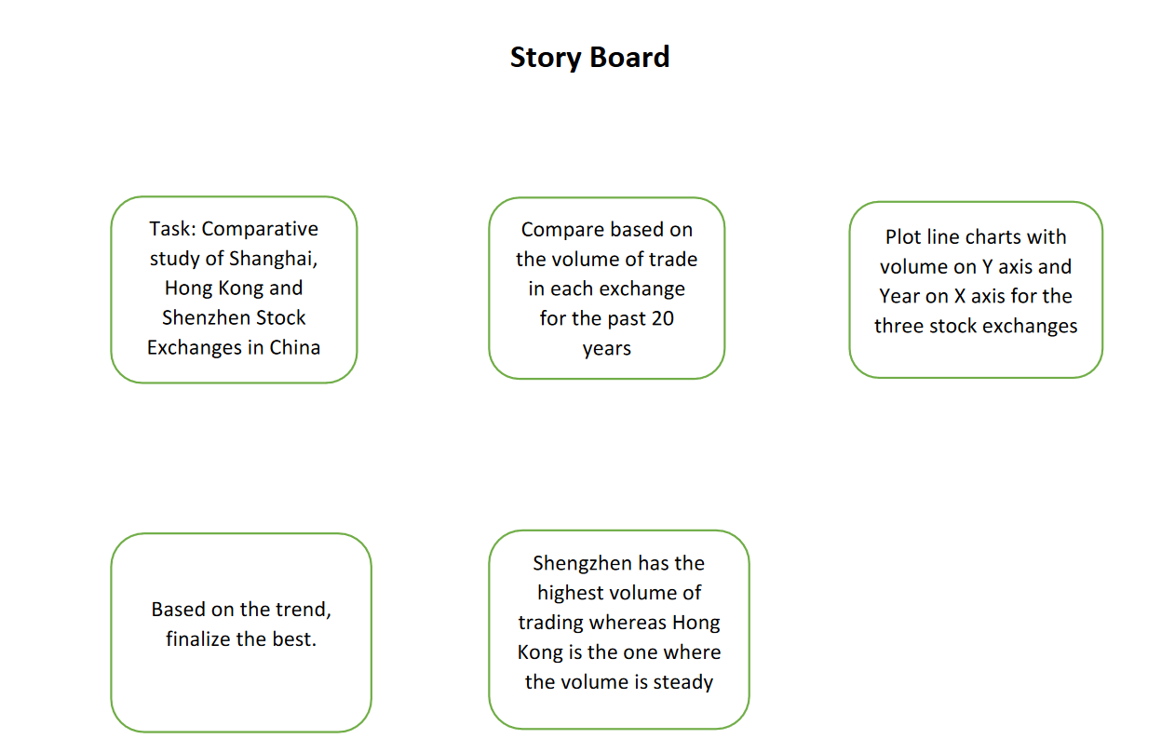
Story Board

Slide 7
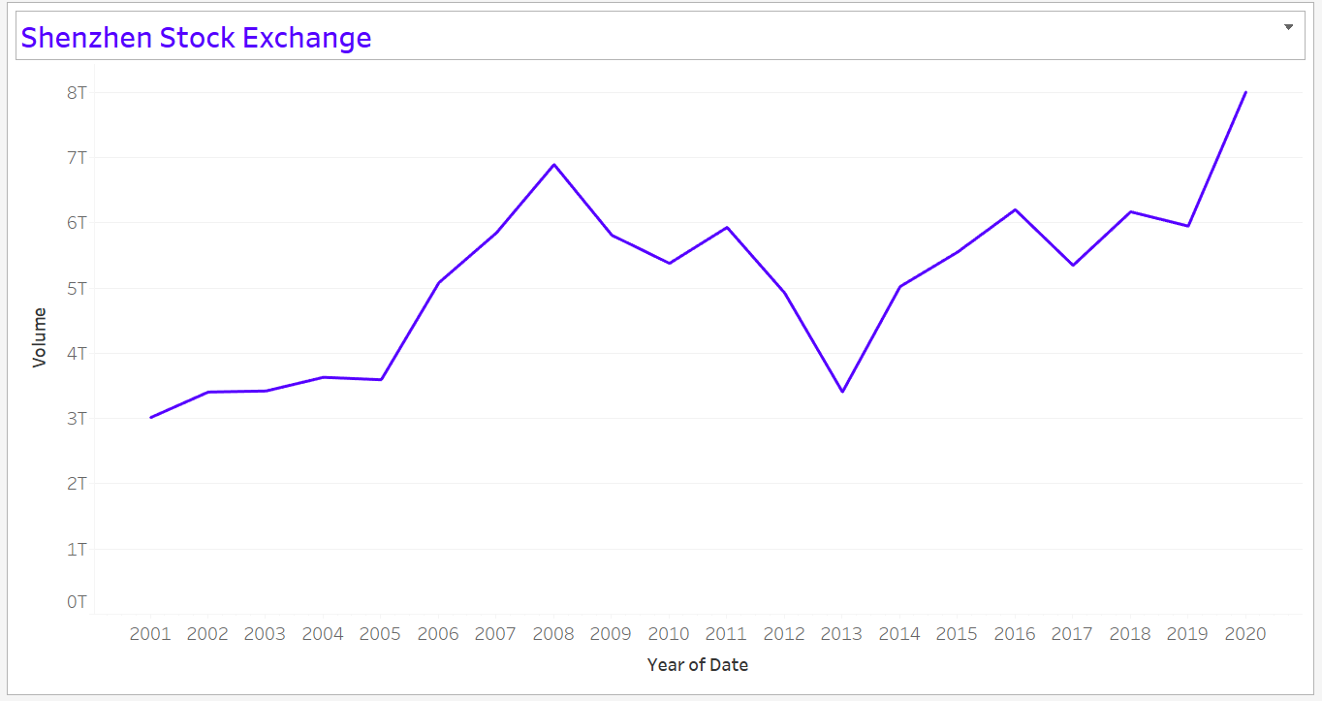
Visualization -1
The type of visualization used to represent this data is line chart.
This is the best suited visualization because, it is a continuous data which shows a trend over time (Knaflic, 2015)
From this chart, it is clear that though there is a rise and fall, in 2013, the volume of trade is more or less stable throughout the period. The chart indicates a stable rise from 2001 to 2020.

Slide 8
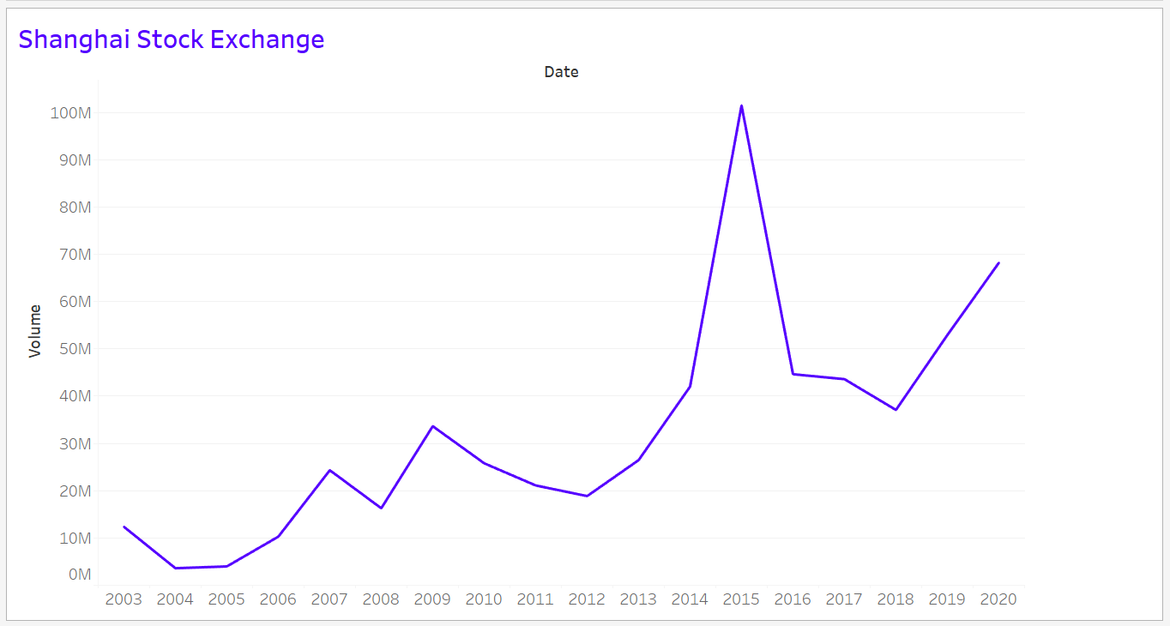
Visualization – 2
The Shanghai Stock Exchange has a slow start in the early 2000s with frequent rise and fall.
In 2015, there is a steep raise in trading, which falls by 50% in the next year.
Then it further decreases in 2018 and from then on, the trend is increasing indicating a good number of sales at the end of 2020.

Slide 9
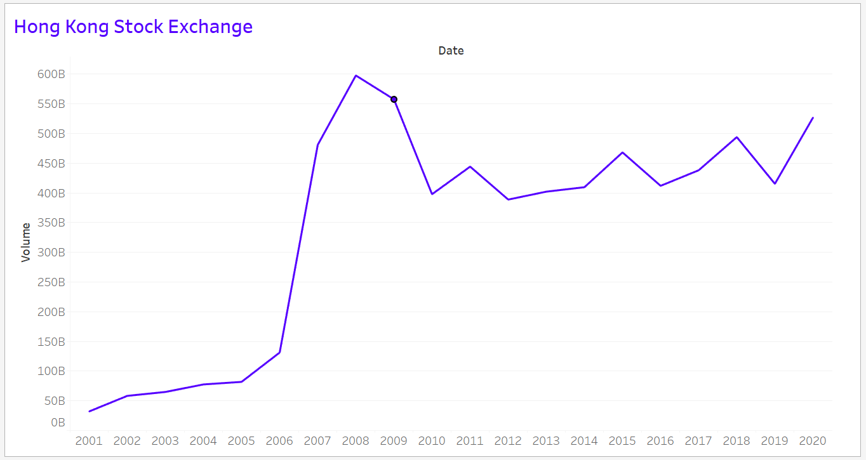
Visualization – 3
With numbers less than 50 billion during the initial years, this market sees a steep increase in the volume of trading after 2006.
Then after 2010 there is a fall, and the trend keeps on increasing and decreasing.
In comparison with other graphs, this will be the one with the most stable trading volume.

Slide 10
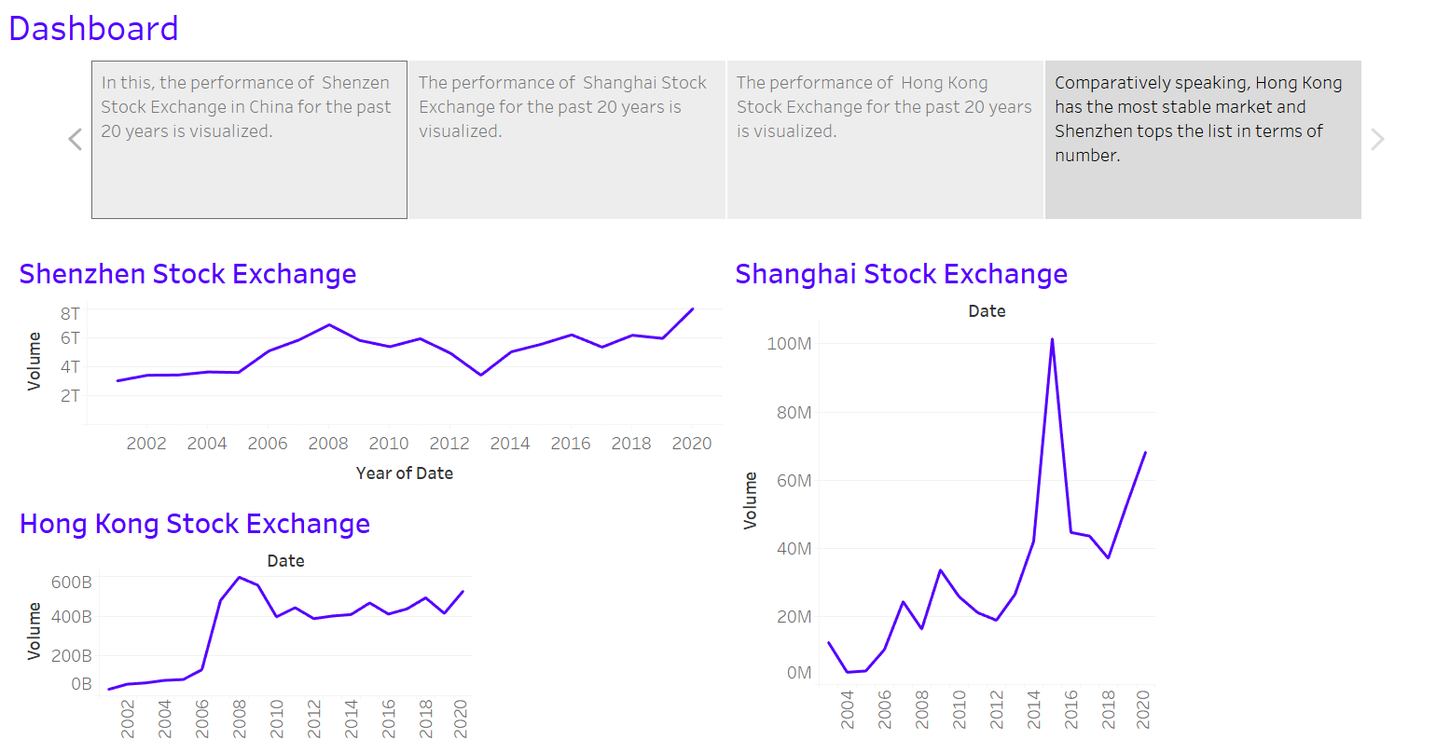
Dashboard

Slide 11
Conclusion
Thus, the datasets are cleaned, and suitable visualizations are created based on the elements of interest from the dataset.
The visualization best suited for the dataset is chosen.
The description of the visualization and the inference from the visualization has also been clearly stated and explained.

Slide 12
References
Robert, B. (2022). DATA1205: Week 07 [PowerPoint slides]. DCConnect. https://durhamcollege.desire2learn.com/
Robert, B. (2022). DATA1205: Week 05 [PowerPoint slides]. DCConnect. https://durhamcollege.desire2learn.com/
Knaflic, C. N. (2015). Storytelling with data: A Data Visualization Guide for Business Professionals. John Wiley &amp; Sons, Inc.

